Slide 1
COMP1003 – Algorithms, Data Structures & Maths Session 12 Numerical Mathematics
Thomas Wennekers
University of Plymouth

Slide 2
Main Ideas
How is Maths done on a Computer?
Arithmetic : ‘inbuilt’: see number representations
Other usually require libraries
Numerical Maths develops the algorithms
Many Algorithms are only approximate (accuracy)

Slide 3
Overview
Linear Algebra; Products, Eigenvectors
Special Functions: sine, cosine, exp, log
Interpolation and extrapolation
Derivative and integral
Zero crossings
Maxima, minima, optimisation
Fast Fourier Transform

Slide 4
Linear Algebra
→ Use linear Algebra libraries (highly optimised)
Matrix-Vector Algebra
products, norms, angles
Inverse and Transposed Matrix
Systems of simultaneous equations
Transformations
Eigenvalues and –vectors
Data analysis
Machine Learning

Slide 5
Special Functions
sine, cosine, exp, log, …
Approximate algorithms can be used
Inbuilt in IDEs or available as Libraries
A HW Co-processor can compute many of these
Most common: Taylor series approximation

Slide 6
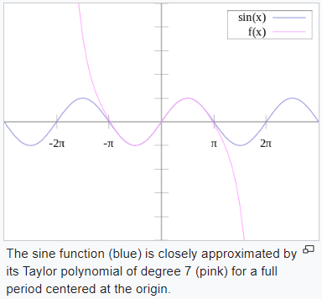
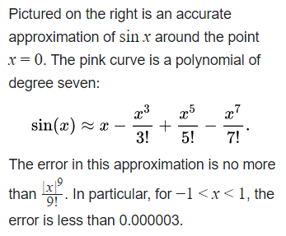
Taylor Series for Sine

Slide 7
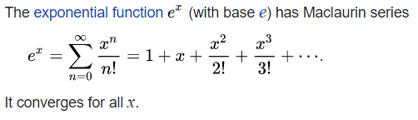
Taylor Series for Exp

Slide 8
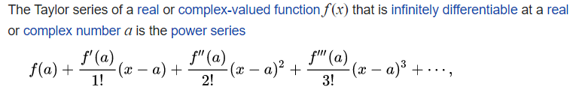
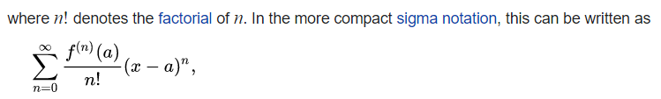
Taylor Series Expansion
For “small enough” (x-a) the series converges to the function value at x

Slide 9
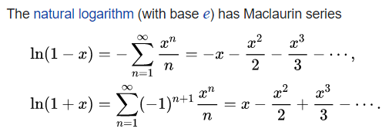
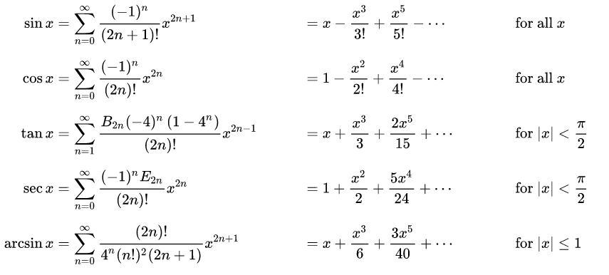
Taylor Series Tables

Slide 10
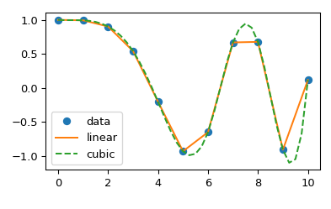
Interpolation and Extrapolation
If we know some points of a function, for example from data, we may be able to interpolate in-between values or to extrapolate outside of the range.
We usually will make small? errors.

Slide 11
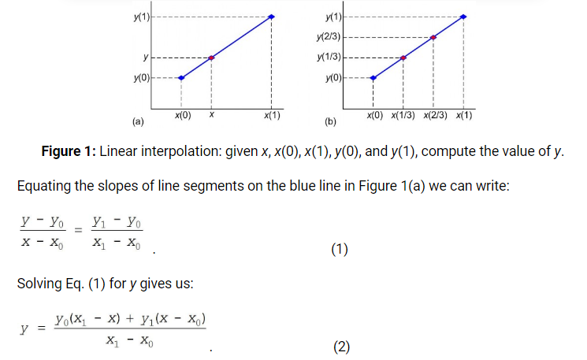
Linear Interpolation
Note: More accurate methods than linear exist, but require more effort. Important in Computer Graphics, 3D rendering

Slide 12
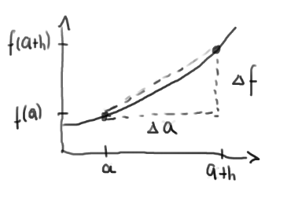


Derivative
Simplest approximation for derivatives uses the secant slope for some small h. This can be inaccurate.

Slide 13
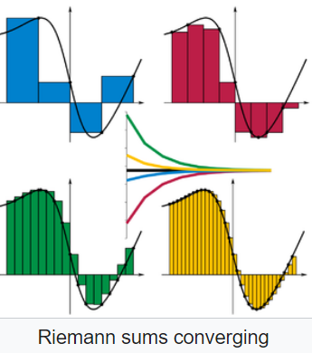
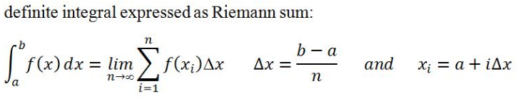
Integral
The simplest approximation for integrals uses Riemann sums for some small delta x
This can be inaccurate

Slide 14
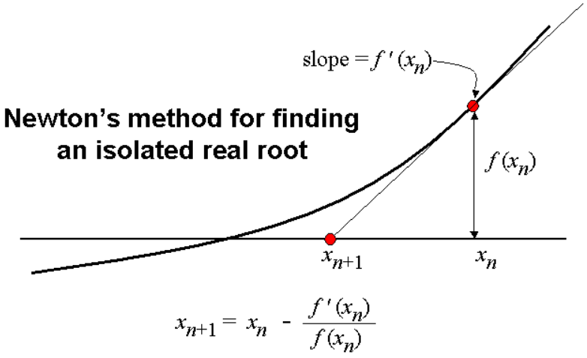
Zero crossings / Roots

Slide 15

Newton’s Method Animation
x₀ should start close to the root

Slide 16


Newton’s Method Derivation
Tangent line (from Taylor Expansion)
Zero crossing of tangent line -> next x value
Solve for x_{n+1}

Slide 17
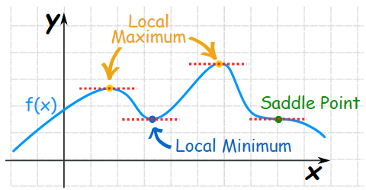
Maxima, Minima
Extrema of differentiable functions usually have optima where their slope is zero, ie their derivative vanishes

Slide 18
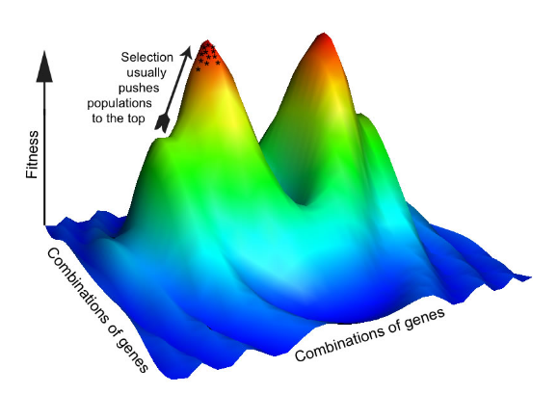
Maxima, Minima and Optimisation
Optimization problems are often based on Extrema fo Fitness functions. (Needs higher-dimensional Maths).

Slide 19
Maxima, Minima, Optimisation
Extrema of differentiable functions usually have optima where their slope is zero, ie their derivative vanishes
To maximize/minimize a function find zero-crossings of its derivative
This may require numerical derivatives (see earlier)
This may fail for wiggly / bad-behaved functions

Slide 20
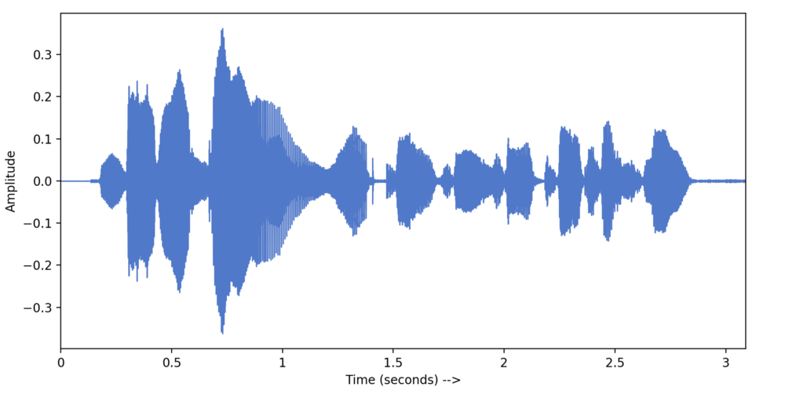
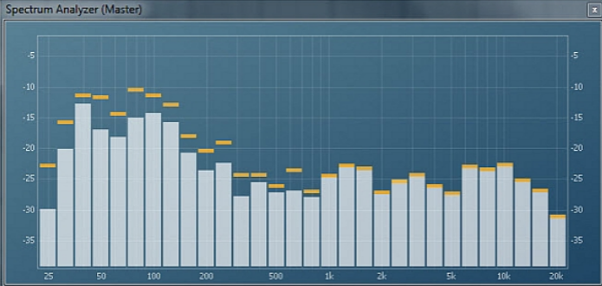
Fourier Transform Sound and Spectrum
Sounds can be described as a superposition of sinusoidal waves, their “Spectrum”
Filtering frequency ranges manipulates the sound

Slide 21
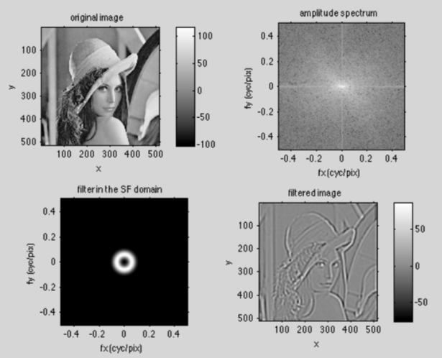
Fourier Transform Image Filtering
Images have 2D spectra; filtering works, too.

Slide 22
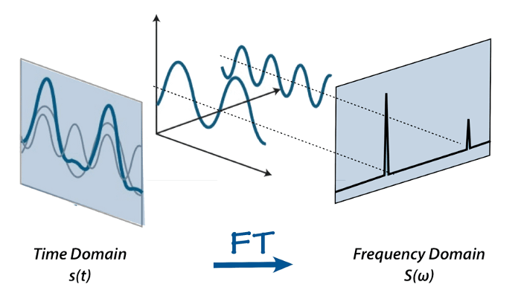
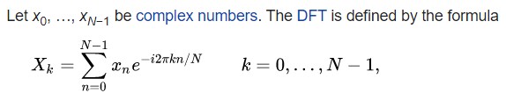
Fast Fourier Transform central in Audio and Video processing
Discrete Fourier Transform (DFT) maps from time to frequency and back
Fast Fourier Transform (FFT) is a faster version
available in libraries

Slide 23
Summary
To solve real world problems one often (almost always?) needs some Mathematics
Maths can be implemented on computers
..but often only in approximate ways
Numerical Maths deals with ways to implement Maths and to guarantee proper results
The session provides some basic algorithms

